Slide 1
PRESENTATION OF JUSTIN

Slide 2
Introduction Justin App
Objective
WireFrame

Slide 3
Introduction
JustIn application mainly focus on immigrants who migrates from one country to another country and provide all the basic needs to user.

Slide 4
Objective
When any new person move to new place they face many problems related to pickup, guidance and accomodation.
In this application, immigrants can discuss their problem with other users and get their views.

Slide 5
WireFrame

Slide 6
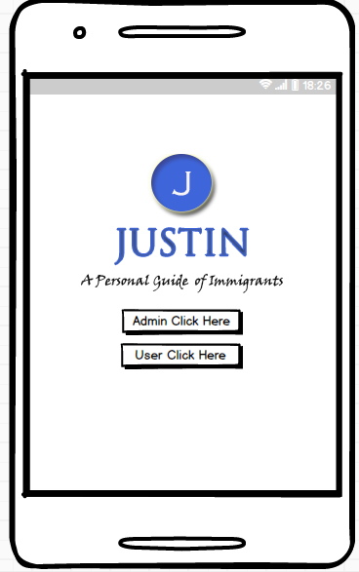
There are mainly two type of login options, one is for Admin and other one for User.

Slide 7
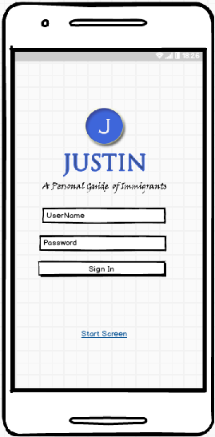
After clicking on Admin login option, this page will open for login and only Admin can access it.

Slide 8
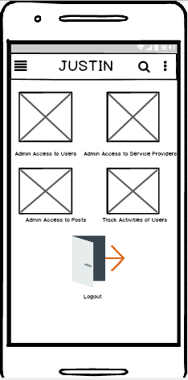
After login, Admin Home page will open.
In this page, Admin can access to Users, Services Providers and Posts.
Admin can also track Activities of Users.

Slide 9
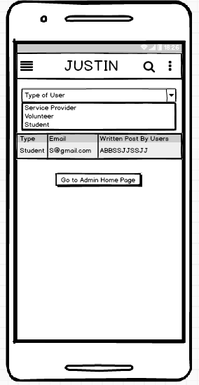
Here Admin can select to Whom he or she wants to access.
After selecting type of User, Admin can see below the type of Users, email id and post written by Users.

Slide 10
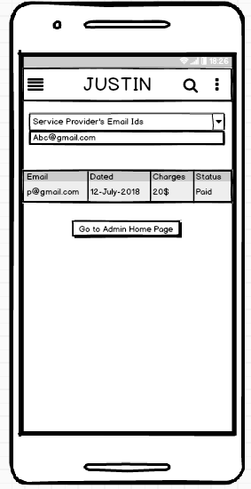
Here, Admin can access all the information of service provider.

Slide 11
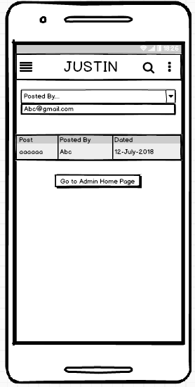
All the posts written by users accessible by Admin.

Slide 12
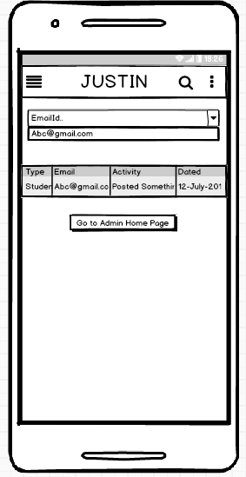
Admin can track all the activities done by the Users.

Slide 13
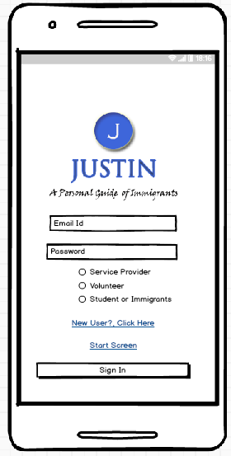
Different kind of User can login here. If person has no account then he or she needs to create account by clicking on new users.

Slide 14
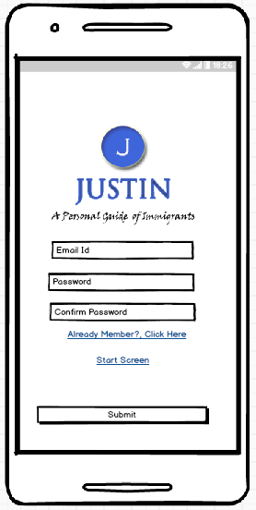
New User will fill all the information to register and submit it.

Slide 15
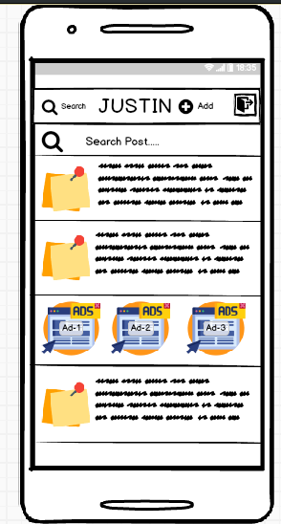
This is the profile picture of host or guest.
Here, user can see the detail of post like who is going to help him, phone number.
User can also see Advertisement by click on it.
This is Users Home Page.

Slide 16
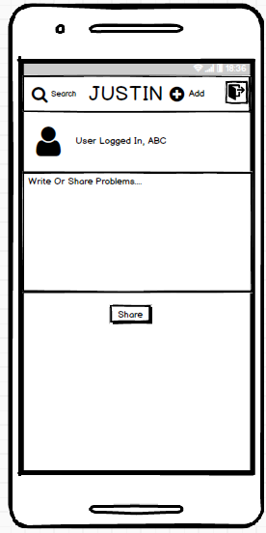
User can write or share problems.

Slide 17
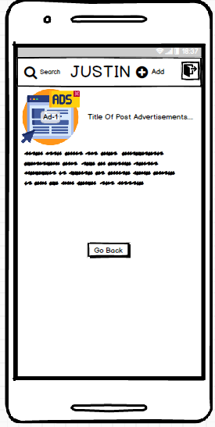
Here, User can check detail of single post.

Slide 18
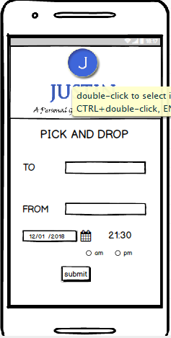
Guest will give the details of pick and drop services such as his starting place and destination place, date and time.

Slide 19
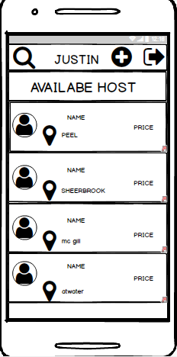
This page will show the available Host on that particular date and time with their name and location.

Slide 20
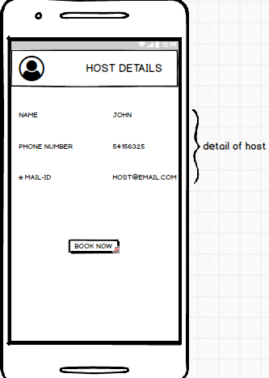
After clicking a particular Host by the Guest, this will show the profile detail of that Host.

Slide 21
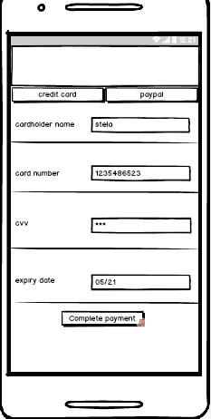
After booking the Host you have to pay for their Service with full authentication process
Payment Form

Slide 22
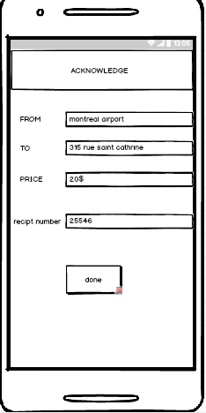
This Page gives confirmation about order to the user.

Slide 23
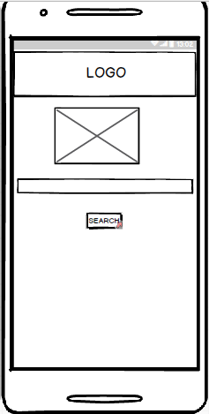
For Volunteer Button
This Page is used to search by the Location

Slide 24
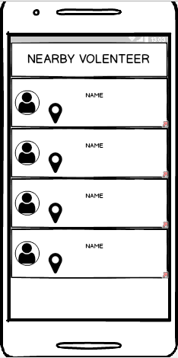
This will give result of near by users

Slide 25
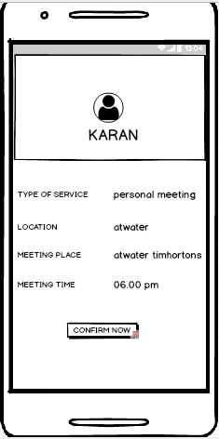
This page shows the details about a selected
volenteer.

